Slide 1
Daily Expense Manager Using MEAN Stack
RAJAT SINGHAL 14BCE094
SARATH KAUL 14BCE104

Slide 2
Core Features:
DashBoard
The dashboard would consist of all accounts created by user.
Total Balance
Latest Records
Navigation Toolbar to navigate to different Features.
A button to insert new Records.

Slide 3
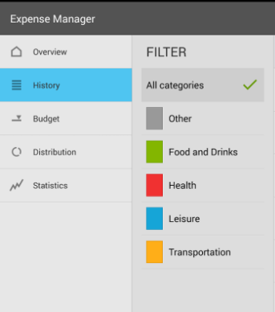
2. Navigation Bar
Monthly Report
Page to view all records(month wise)
Income expense Charts
Some other Features
3. User can insert future Payment
4. Debts can be inserted
5. Individual account can be maintained separately

Slide 4
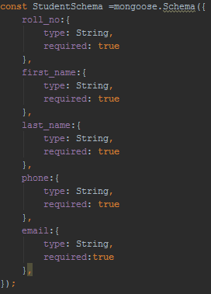
Use of MongoDB
We would be using MongoDB as our database to store all the records and user related information like login info, accounts created by user etc.

Slide 5
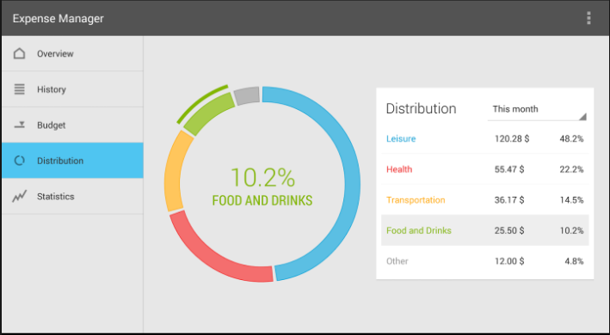
Use of angularJs
The whole UI would be designed using the AngularJS. We have seen some wallet applications and we would be designing the UI as simple as possible so user can easily use the UI.

Slide 6
Use of NODEJS
NodeJS would be user for the backend connectivity between the UI and MongoDB. It would fetch records from the database and same would be reflected into the UI.

